Slide 1
History Of Computer AND SIGNIFICANT ADVANTAGES
ASSIGNMENT: 01
SYED SHAH HUSSAIN BADSHAH
(FA21-BSE-083)

Slide 2
SUBMITTED BY: SYED SHAH HUSSAIN BADSHAH
SUBMITTED TO: MA’AM SAJIDA KALSOOM
REGISTRATION NO: FA21-BSE-083
SUBJECT: INTRODUCTION TO ICT (LAB ASSIGNMENT)

Slide 3
Origin Of Computers:
The history of computing hardware starting at 1960 is marked by the conversion from vacuum tube to solid-state devices such as transistors and then integrated circuit (IC) chips. Around 1953 - 1959, discrete transistors started being considered sufficiently reliable and economical that they made further vacuum tube computers uncompetitive. Metal-oxide-semiconductor (MOS) large-scale integration (LSI) technology subsequently led to the development of semiconductor memory in the mid-to-late 1960s and then the microprocessor in the early 1970s. This led to primary computer memory moving away from magnetic-core memory devices to solid-state static and dynamic semiconductor memory, which greatly reduced the cost, size, and power consumption of computers. These advances led to the miniaturized personal computer (PC) in the 1970s, starting with home computers and desktop computers, followed by laptops and then mobile computers over the next several decades.

Slide 4
Abacus:
The abacus (plural abaci or abacuses), also called a counting frame, is a calculating tool which has been used since ancient times. It was used in the ancient Near East, Europe, China, and Russia, centuries before the adoption of the Arabic numeral system.[1] The exact origin of the abacus has not yet emerged. It consists of rows of movable beads, or similar objects, strung on a wire. They represent digits. One of the two numbers is set up, and the beads are manipulated to perform an operation such as addition, or even a square or cubic root.
In their earliest designs, the rows of beads could be loose on a flat surface or sliding in grooves. Later the beads were made to slide on rods and built into a frame, allowing faster manipulation. Abacuses are still made, often as a bamboo frame with beads sliding on wires. In the ancient world, particularly before the introduction of positional notation, abacuses were a practical calculating tool. The abacus is still used to teach the fundamentals of mathematics to some children, e.g., in post-Soviet states.
Designs such as the Japanese soroban, have been used for practical calculations of up to multi-digit numbers. Any particular abacus design supports multiple methods to perform calculations, including the four basic operations and square and cube roots. Some of these methods work with non-natural numbers (numbers such as 1.5 and 3⁄4).
Although calculators and computers are commonly used today instead of abacuses, abacuses remain in everyday use in some countries. Merchants, traders, and clerks in some parts of Eastern Europe, Russia, China, and Africa use abacuses. The abacus remains in common use as a scoring system in non-electronic table games. Others may use an abacus due to visual impairment that prevents the use of a calculator.[1]

Slide 5
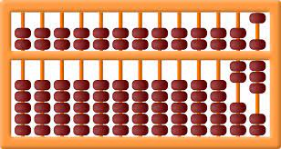
Picture Of Abacus:

Slide 6
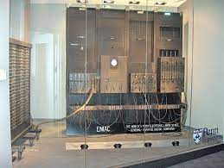
First Computer:
The first substantial computer was the giant ENIAC machine by John W. Mauchly and J. Presper Eckert at the University of Pennsylvania. ENIAC (Electrical Numerical Integrator and Calculator) used a word of 10 decimal digits instead of binary ones like previous automated calculators/computers.

Slide 7
Generations Of Computers:
First Generation:
The period of first generation: 1946-1959. Vacuum tube based.
Second Generation:
The period of second generation: 1959-1965. Transistor based.
Third Generation:
The period of third generation: 1965-1971. Integrated Circuit based.
Fourth Generation:
The period of fourth generation: 1971-1980. VLSI microprocessor based.
Fifth Generation:
The period of fifth generation: 1980-onwards. ULSI microprocessor based.

Slide 8
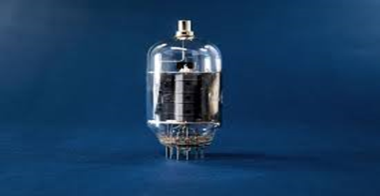
Advantages And Disadvantages Of Computer Generations
1ST Generation:
Introduction:
1946-1959 is the period of first generation computer.
J.P.Eckert and J.W.Mauchy invented the first successful electronic computer called ENIAC, ENIAC stands for “Electronic Numeric Integrated And Calculator”.
Few Examples are:
ENIAC
EDVAC
UNIVAC
Advantages:
It made use of vacuum tubes which are the only electronic component available during those days.
These computers could calculate in milliseconds.
Disadvantages:
These were very big in size, weight was about 30 tones.
These computers were based on vacuum tubes.

Slide 9
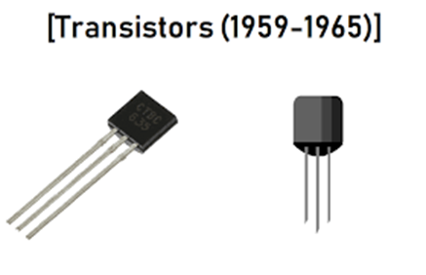
2nd Generation:
Introduction:
1959-1965 is the period of second-generation computer.
3.Second generation computers were based on Transistor instead of vacuum tubes.
Few Examples are:
Honeywell 400
IBM 7094
Advantages:
Due to the presence of transistors instead of vacuum tubes, the size of electron component decreased. This resulted in reducing the size of a computer as compared to first generation computers.
Less energy and not produce as much heat as the first generation.
Assembly language and punch cards were used for input.
Disadvantages:
A cooling system was required.
Constant maintenance was required.

Slide 10
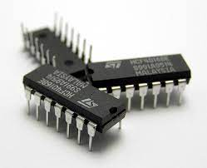
3rd Generation:
Introduction:
1965-1971 is the period of third generation computer.
These computers were based on Integrated circuits.
IC was invented by Robert Noyce and Jack Kilby In 1958-1959.
IC was a single component containing number of transistors.
Few Examples are:
IBM 360
IBM 370
Advantages:
These computers were cheaper as compared to second-generation computers.
They were fast and reliable.
Disadvantages:
IC chips are difficult to maintain.
The highly sophisticated technology required for the manufacturing of IC chips.
Air conditioning is required.

Slide 11
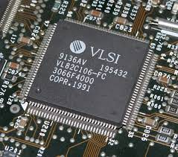
4Th Generation:
Introduction:
1971-1980 is the period of fourth generation computer.
This technology is based on Microprocessor.
A microprocessor is used in a computer for any logical and arithmetic function to be performed in any program.
Graphics User Interface (GUI) technology was exploited to offer more comfort to users.
Few Examples are:
IBM 4341
PUP 11
Advantages:
Fastest in computation and size get reduced as compared to the previous generation of computer.
Disadvantages:
The Microprocessor design and fabrication are very complex.
Air conditioning is required in many cases due to the presence of ICs.
Advance technology is required to make the ICs.

Slide 12
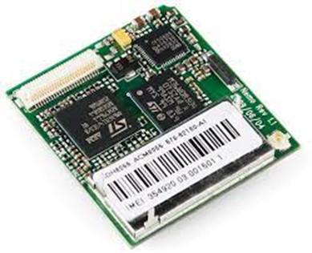
5th Generation:
Introduction:
The period of the fifth generation in 1980-onwards.
This generation is based on artificial intelligence.
The aim of the fifth generation is to make a device which could respond to natural language input and are capable of learning and self-organization.
This generation is based on ULSI(Ultra Large Scale Integration) technology resulting in the production of microprocessor chips having ten million electronic component.
Few Examples are:
Desktop
Laptop
Advantages:
It is more reliable and works faster.
It is available in different sizes and unique features.

Slide 13
Classification Of Computers:
PC (Personal Computer) or Micro-Computers:
It is a single user computer system having a moderately powerful microprocessor. It is termed as a computer that is equipped microprocessor as its CPU.
Workstation:
It is also a single user computer system, similar to the personal computer, however, has a more powerful microprocessor.
Mini-Computer:
It is a multi-user computer system, capable of supporting hundreds of users simultaneously.
Main Frame:
It is a multi-user computer system, capable of supporting hundreds of users simultaneously. Software technology is different from minicomputer.
Super-Computer:
It is an extremely fast computer, which can execute hundreds of millions of instructions per second.

Slide 14
References:
History Of Computer's: https://en.wikipedia.org/wiki/History_of_computing_hardware_(1960s%E2%80%93present)
Abacus:
https://en.wikipedia.org/wiki/Abacus
Generation Of Computers:
https://www.geeksforgeeks.org/generations-of-computer/

